Slide 1
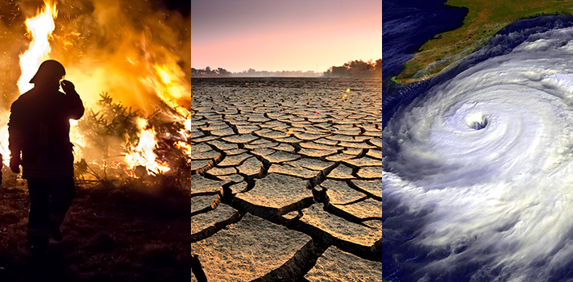
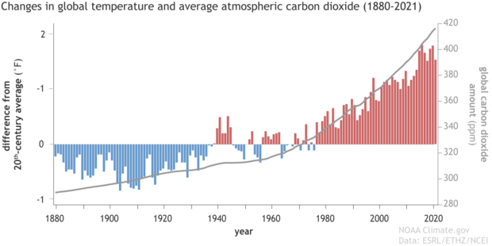
What are these images trying to show?
These pictures show the impact of climate change. We know there are lots more as well.
This image shows the evidence of climate change being caused by humans.
Together, these images should give us a reason to change our behaviour to slow climate change.

Slide 2
Do now activity…
From last lesson, why do people do things which contribute to climate change?
What’s a Buddhist explanation for people choosing to do bad?
What’s a Christian explanation for people choosing to do bad?
1. People may act in their own interest or the interest of people around them. E.g. a mayor allowing deforestation because it makes their community money. 2. People may do things that they enjoy, despite knowing they are bad. E.g. eating meat and dairy, buying lots of “stuff”.
The three poisons: greed, ignorance and anger/hatred.
“The fall”. Adam and Eve being tempted describes how we are also tempted.

Slide 3
Climate Change Lesson 3: Why should we change?
Learning Intention: To understand what religious responses are to climate change.
Success criteria 1: To understand some Christian responses.
Success criteria 2: To understand some Islamic responses.
Success criteria 3: To understand some Buddhist responses.
Notes:
It may be worth mentioning here that given the scientific evidence, everyone should be bothered out of self interest. However, this lesson looks at the religious reasons that we should be bothered.

Slide 4
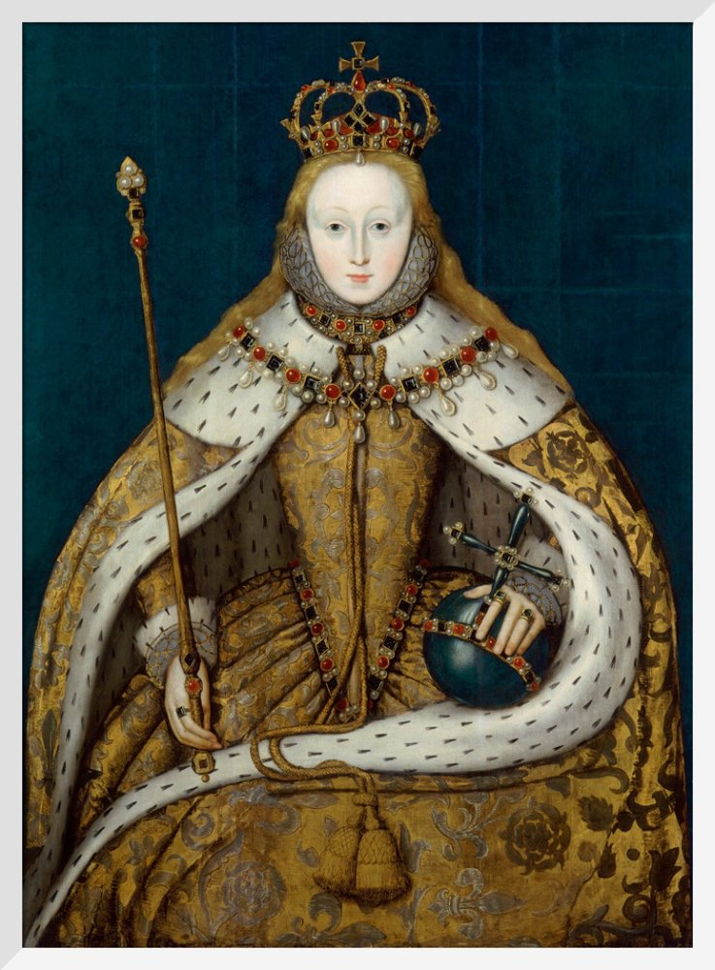
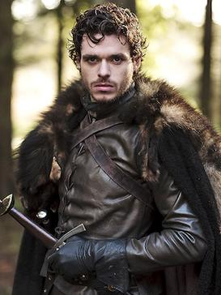
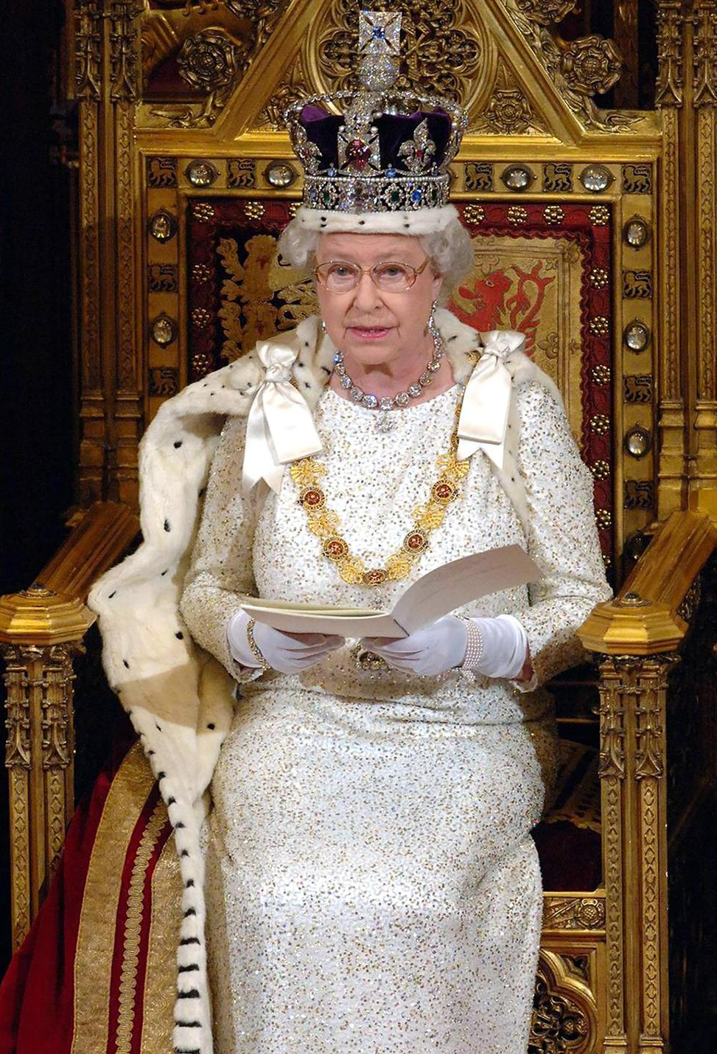
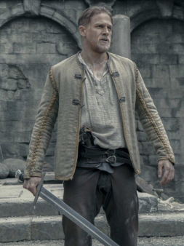
Success criteria 1: To understand some Christian responses.
To understand why Christians are bothered about climate change it may first be useful to take a detour…
What makes a good ruler? (King/Queen)
To understand why Christians are bothered about climate change from a religious point of view, it’s useful to go back to the Bible…
Notes:
Write some of the ideas on the board. E.g. Fair, strong, wise, committed, has a duty to subjects, caring…

Slide 5
Success criteria 1: To understand some Christian responses.
To understand why Christians are bothered about climate change from a religious point of view, it’s useful to go back to the Bible…
Genesis 1:
26 Then God said, “Let us make mankind in our image, in our likeness, so that they may rule over the fish in the sea and the birds in the sky, over the livestock and all the wild animals,[a] and over all the creatures that move along the ground.”
27 So God created mankind in his own image,
in the image of God he created them;
male and female he created them.
28 God blessed them and said to them, “Be fruitful and increase in number; fill the earth and subdue it. Rule over the fish in the sea and the birds in the sky and over every living creature that moves on the ground.”
Thinking about what we said makes a good ruler, what do you think a Christian might say about this part of the Bible?
Do we have a responsibility towards the natural world?
The idea that we’re in charge of the world is often called “dominion”.
What do you think about this passage?
Genesis 2:
15 The Lord God took the man and put him in the Garden of Eden to work it and take care of it.
Do we have a responsibility towards the natural world?
The idea that we should take care of the natural world is called “stewardship”.

Slide 6
Success criteria 1: To understand some Christian responses.
Complete the following paragraph using the words at the side.
Christians think that ______ has created the world for us to use and enjoy. This is written about in ______ , at the start of the Bible. God has put humanity in charge and this is often called _______ . However, we also have a _______ towards the natural world – we are to care for it. This is often called _______. Many Christians think that _________ is something that humans have a responsibility to work to slow/reduce.
climate change responsibility
Genesis
God
Dominion
stewardship
Extension
How far do you think humanity is required to go to fulfil dominion and stewardship?
Stop using oil? Become vegetarian? Quit flying on planes?

Slide 7
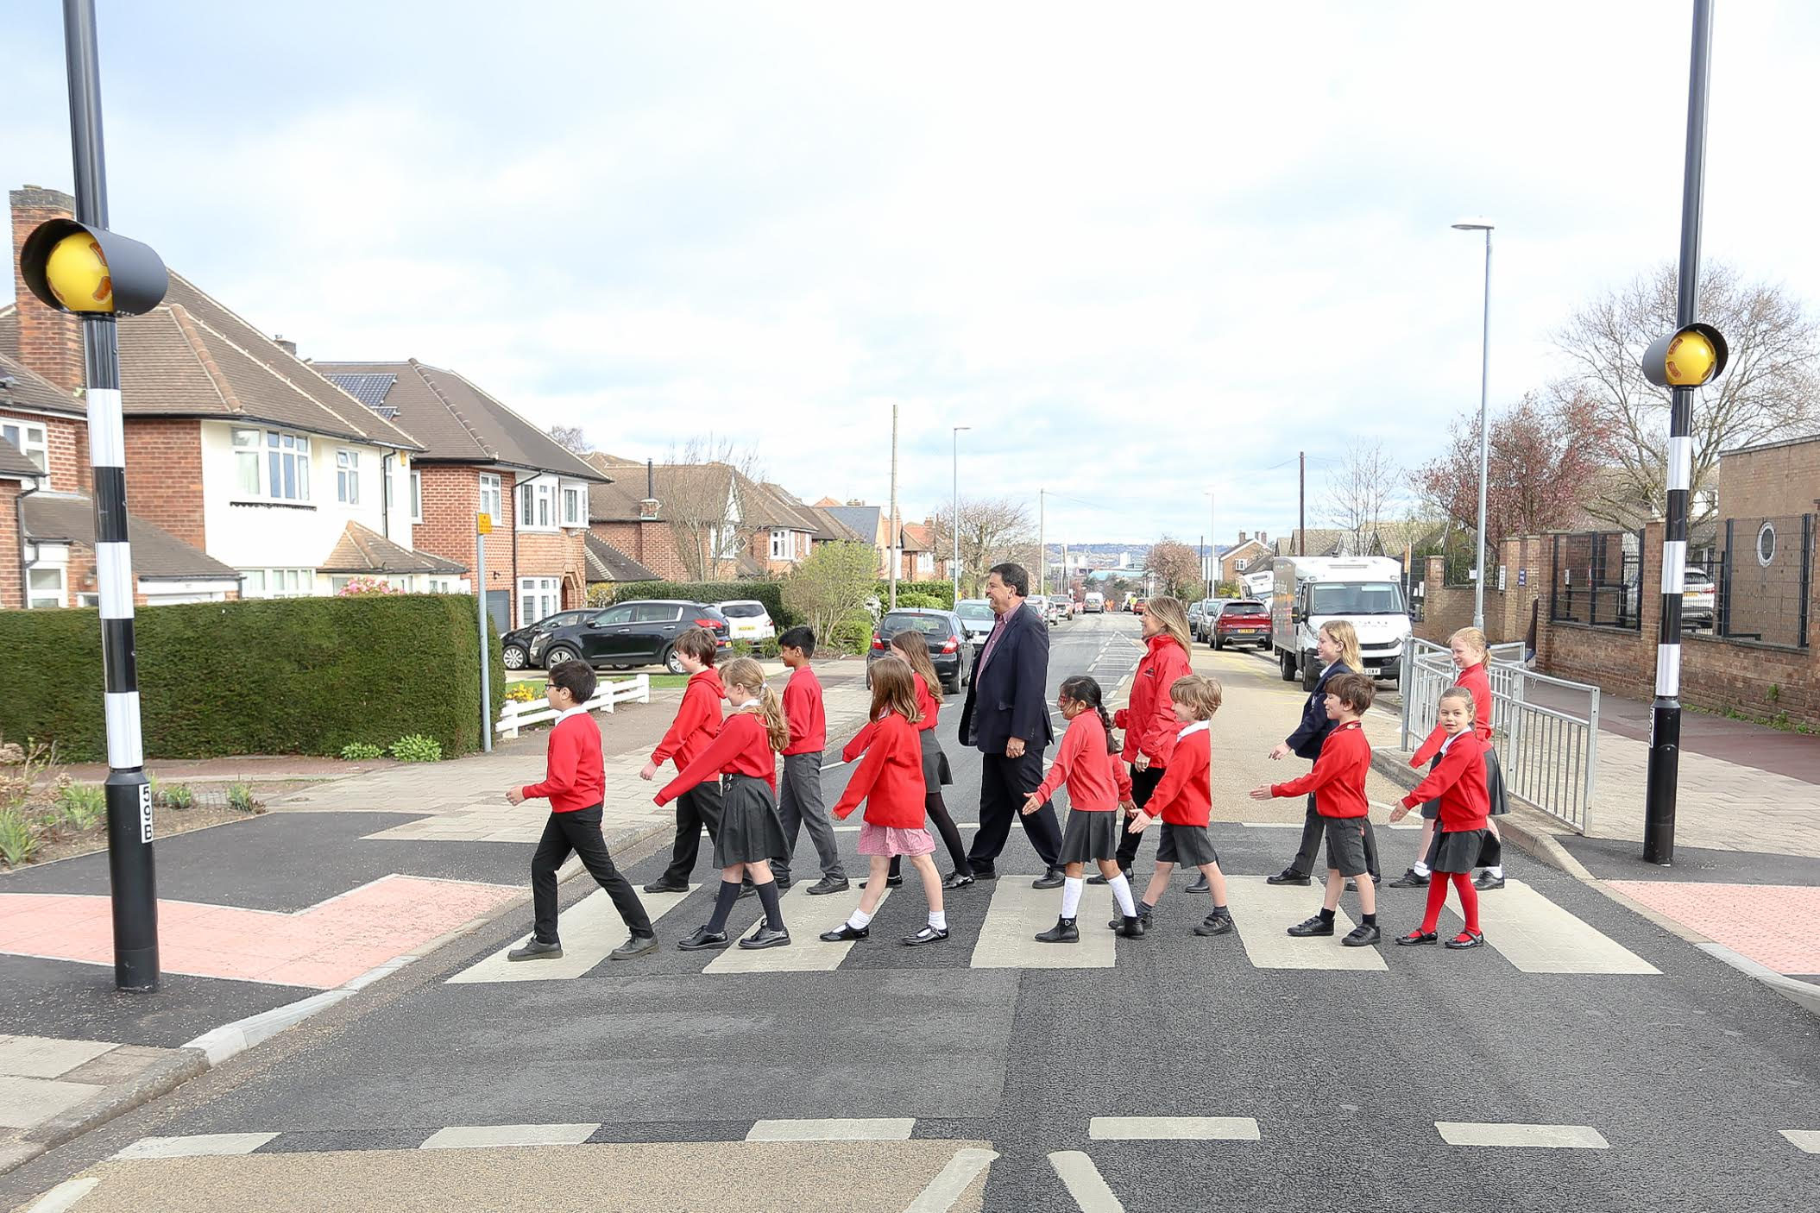
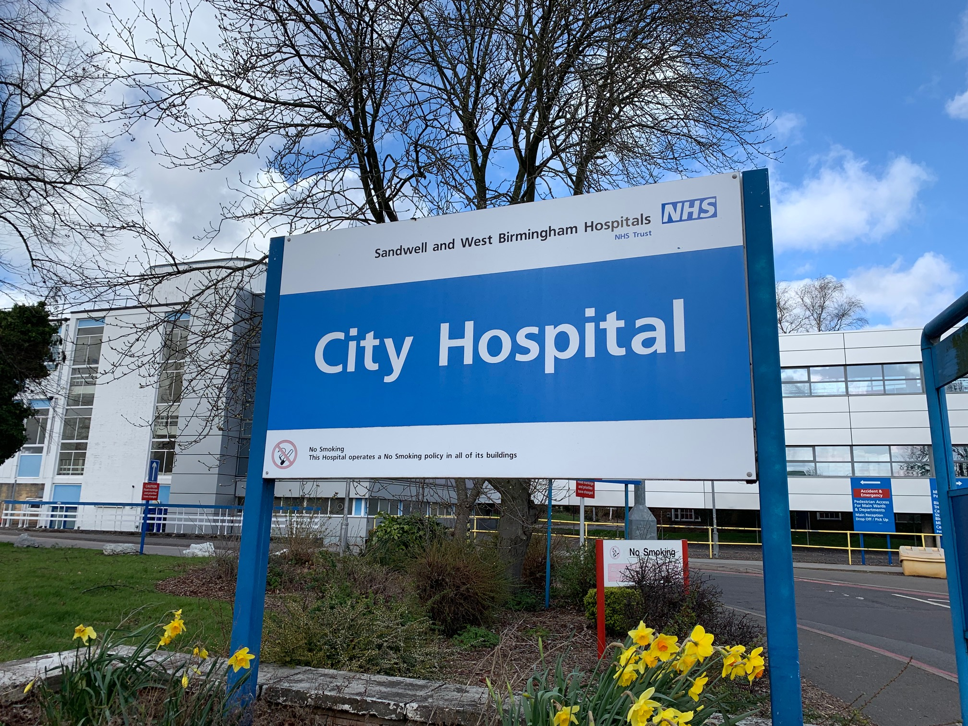
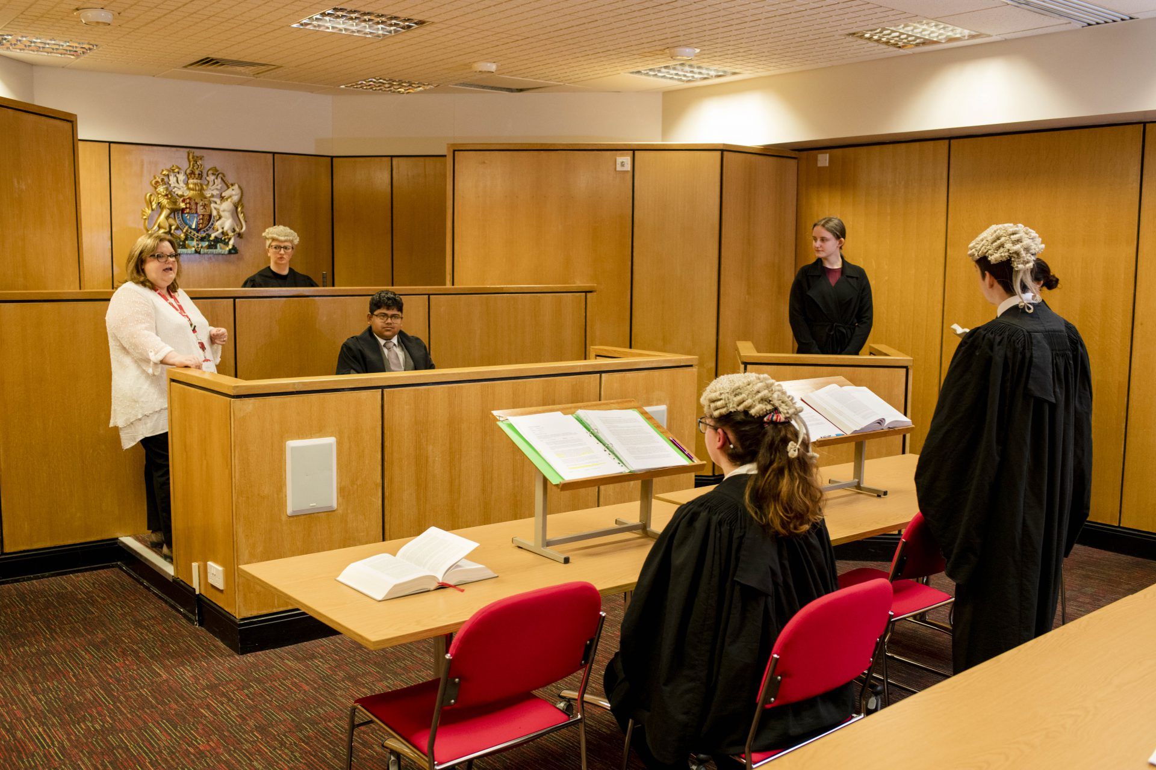
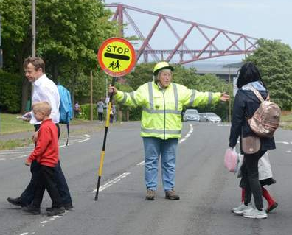
Success criteria 2: To understand some Islamic responses.
Like Christians, Muslims believe that Allah (God) has created the world for humans to enjoy and care for.
There are other teachings that also guide Muslims when thinking about the environment and climate change.
To help us understand those teachings, we should consider some things we do every day…
Why do we have these things in our country?
“public interest” (wellbeing)

Slide 8
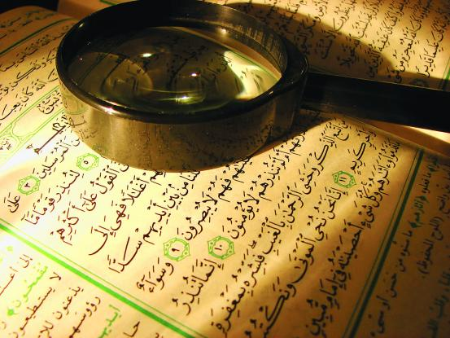
Success criteria 2: To understand some Islamic responses.
In Islam there is a concept called Maslahah which translates to “public interest”. On the previous slide, we saw examples of things that we have in the UK because of public interest (the wellbeing of the public).
Maslahah has been interpreted by Muslim environmentalists to mean that our actions should care for future generations, not just the wellbeing of the public who are alive right now.
Write down an explanation of Maslahah and its relation to the environment.
Can you think of any other issues that may be related to Maslahah?

Slide 9
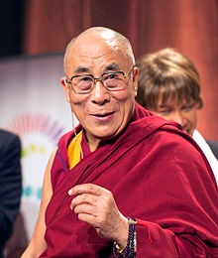
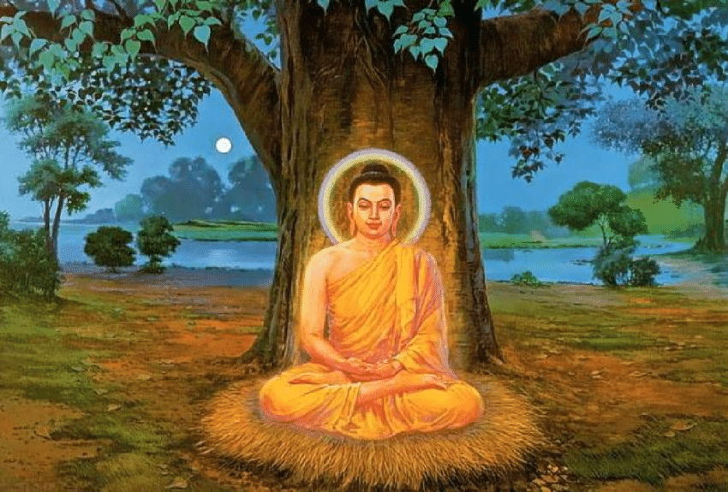
Success criteria 3: To understand some Buddhist responses.
Like Christians and Muslims, Buddhists also think we should care for the environment.
“We are the generation with the awareness of a great danger. We are the ones with the responsibility and the ability to take steps of concrete action, before it is too late”
-Dalai Lama, leader of Tibetan Buddhists
Tenzin Gyatso
14th Dalai Lama
The Buddha achieved enlightenment (understanding) under a tree.

Slide 10
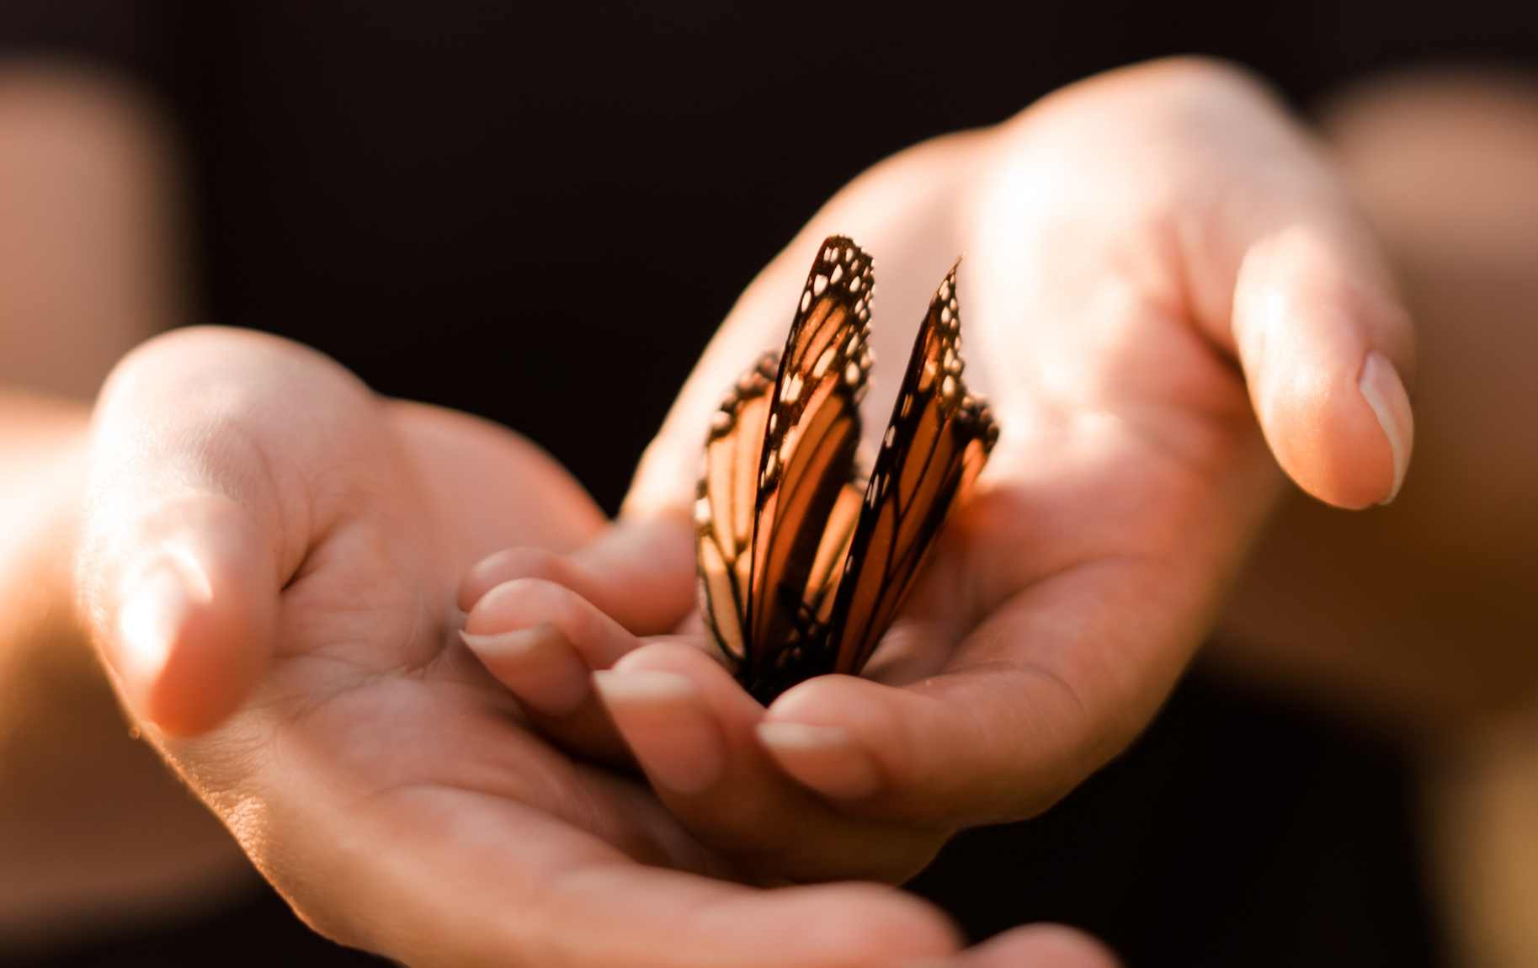

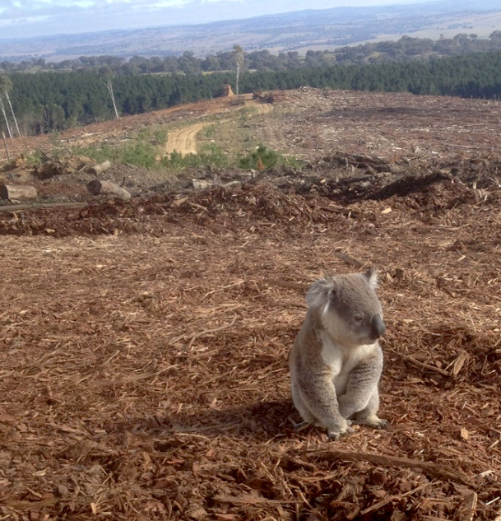
Success criteria 3: To understand some Buddhist responses.
There are other reasons why Buddhists may want to reduce climate change. Write these down as we go through them…
Ahimsa is the ethical principle of not causing harm to other living things.
The first of the Five Precepts in Buddhism is to avoid harming/killing other living things.
By damaging the planet, we are harming other living things and their habitat/homes.
The Noble Eightfold Path sets out what a Buddhist should do to achieve enlightenment (understanding) and escape rebirth.
The parts that link to the environment strongly are: right intention, right action, and right livelihood.
Intentionally damaging the earth would clash with these.

Slide 11


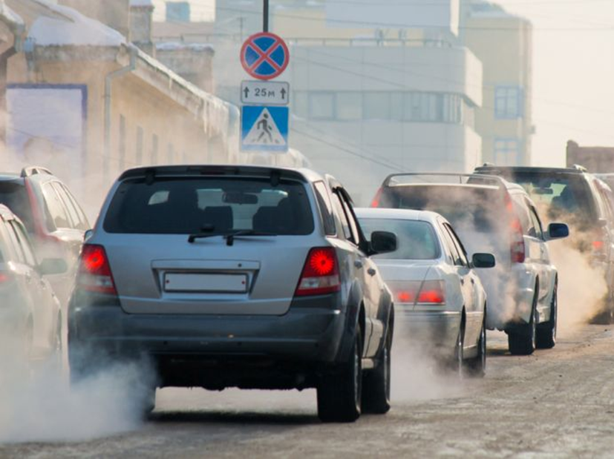

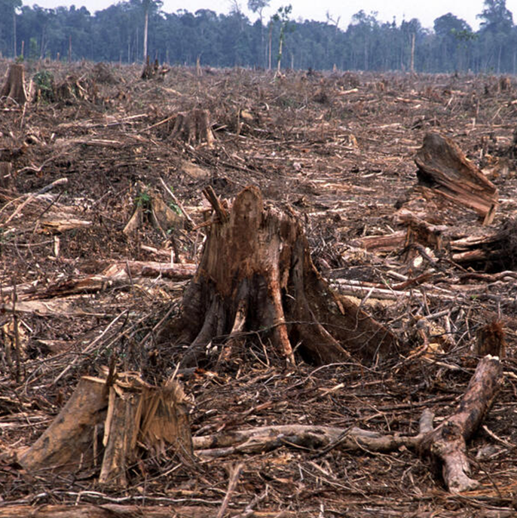
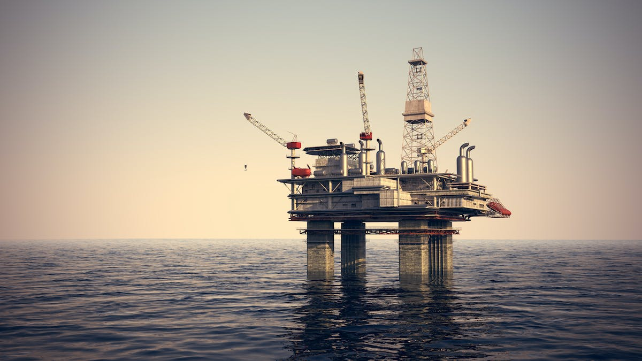
Thinking about today’s lesson, what do you think?
Write a paragraph explaining your point of view.
-Should we all change our behaviour to slow climate change?
-Why should we change? Or if not, why not?
-To what extent should we change?
E.g. should we all become vegetarian, stop flying. How far should we go?

